Slide 1

Secure Elections in Brazos County

Slide 2
Lead Staff
Voter Registration
  Kathy Schuetze, Voter Registration Coordinator
  Regina White, Asst. Voter Registration Coordinator
Elections
  Krystal Ocon, Elections Coordinator
  Paul Velasquez, Asst. Elections Coordinator/Ballot by Mail Clerk
Equipment
  Raymond Rodriguez, Warehouse Manager
IT Department
  Anthony Lane

Slide 3
How do we insure SECURE elections?
Staff (County Employees, Judges, clerks,& poll watchers)
Certified Equipment
Testing
Verify results

Slide 4
Staff
County Employees
Election Workers
Poll Watchers
County Employees
Voter Registration
Elections, IT, Warehouse
Election Workers
Judges/Alternate Judge
Clerks
Poll watchers
Early Voting/ Election Day
EVBB/Central Count

Slide 5
Voting Equipment
Hart Verity is certified on Federal and State levels (https://www.eac.gov/admin/voting-system-update and https://www.sos.state.tx.us/elections/laws/certinfobyvendor.shtml)
Regular maintenance, updates and necessary repairs
Stored in a secure climate-controlled location
Chain of Custody

Slide 6
Testing
In house logic and accuracy
Public Test
Second Test
Third Test

Slide 7
How do we Verify Results?
Early Voting
Daily cross check of numbers
Election Day
Central Count Verification
Final Reconciliation
All Votes Cast
Canvass
Reconciliation
Partial Manual Count
3 Precincts Early Voting
3 Locations for Election Day
Print ALL required tapes
Precinct by Precinct Results
Ballot ID Report
Early Voting
Election Day
Print all required tapes
Reconciliation
Partial Manual Count

Slide 8
Reconciliation
Reconciliation is performed on election night of “Unofficial” votes.
Reconciliation is performed with the canvass of the “Official” votes.

Slide 9
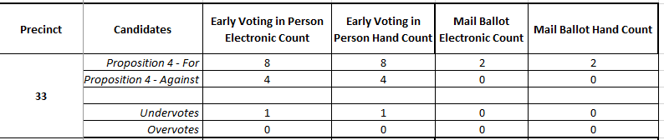
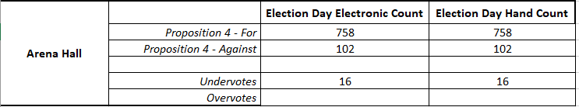
Partial Manual Count
TEC 127.201 requires a partial manual count after every election of 1% of precincts or 3 precincts, whichever is greater.
Counties using the vote center model are allowed to count 3 election day locations instead of precincts.
Expanded PMC for November 2023 Election.
Performed by election workers from both parties.

Slide 10
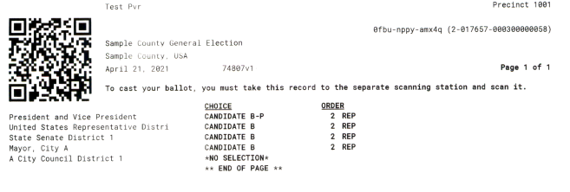
What is in the QR code?
The QR Code is a security hash that lets the Verity Scan know that the ballot is a secure ballot that was issued from a Verity DUO assigned to this election.

Slide 11
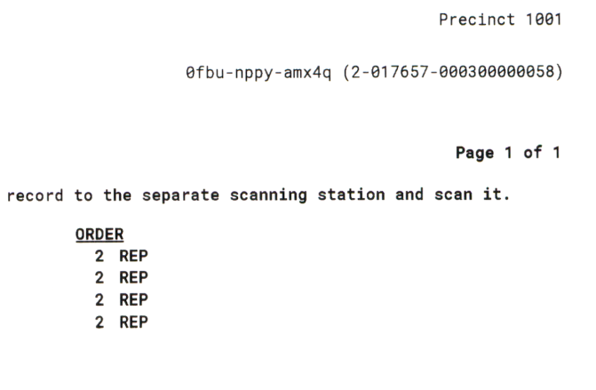
Ballot Numbering –
Random electronic or Pre-numbered
Human Readable Unique Identifier
Device Type – DUO is 2
Device ID – Serial number of device
Session Number – We do not use Controller more than once in a cycle
Random number generated by Controller
2-017657-000300000058
Device Type
Device ID
Session Number
Random Number

Slide 12
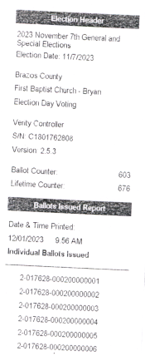
Ballots Issued Report
Election
Location
Equipment Information
Ballot Count
List of Ballots Issued

Slide 13
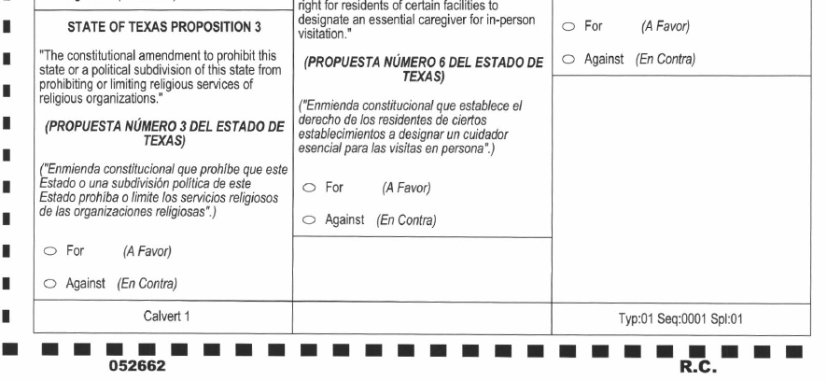
Pre-Numbered Ballots
Printed ballot that has a serial number printed on it.
Range of serial numbers are assigned to a location.
Judge shuffles ballots.
Voter chooses his ballot.
Part of the election records and must be stored for 22 months before being destroyed.
Same rules for ballot stock with pre-printed serial numbers.

Slide 14
Contact Information
Trudy Hancock, REO, CERA
Elections Administrator
thancock@brazoscountytx.gov
Krystal Ocon, REO
Elections Coordinator
kocon@brazoscountytx.gov
Paul Velasquez
Asst. Elections Coordinator/Ballots by Mail
pvelasquez@brazoscountytx.gov
Kathy Schuetze
Voter Registration Coordinator
kschuetze@brazoscountytx.gov
Regina White
Asst. Voter Registration Coordinator
rwhite@brazoscountytx.gov
Raymond Rodriguez
Warehouse Manager
rrodriguez@brazoscountytx.gov
300 E William J Bryan Pkwy, Suite 100
Bryan, Texas 77803
979-361-5770 (Main)
979-361-5779 (Fax)

